Slide 1
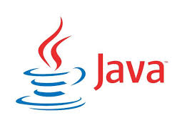
CS212: Object-Oriented Programming
Java Basics, Input/Output, Primitive Data Types and Arithmetic Operations
Instructor: Hirra Anwar

Slide 2
History of C and C++
C++
Evolved from C
Evolved from BCPL and B
Provides object-oriented programming capabilities
Objects
Reusable software components that model real-world items

Slide 3
History of Java
Java
Originally for intelligent consumer-electronic devices
Then used for creating Web pages with dynamic content
Now also used to:
Develop large-scale enterprise applications
Enhance WWW server functionality
Provide applications for consumer devices (cell phones, etc.)

Slide 4
Java Class Libraries
Classes
Include methods that perform tasks
Return information after task completion
Used to build Java programs
Java provides class libraries
Known as Java APIs (Application Programming Interfaces)
Use a building-block approach to create programs. Avoid reinventing the wheel—use existing pieces wherever possible. Called software reuse, this practice is central to object-oriented programming.

Slide 5
Typical Java Development Environment
Java programs normally undergo five phases
Edit
Programmer writes program (and stores program on disk)
Compile
Compiler creates bytecodes from program
Load
Class loader stores bytecodes in memory
Verify
Bytecode Verifier confirms bytecodes do not violate security restrictions
Execute
JVM translates bytecodes into machine language

Slide 6
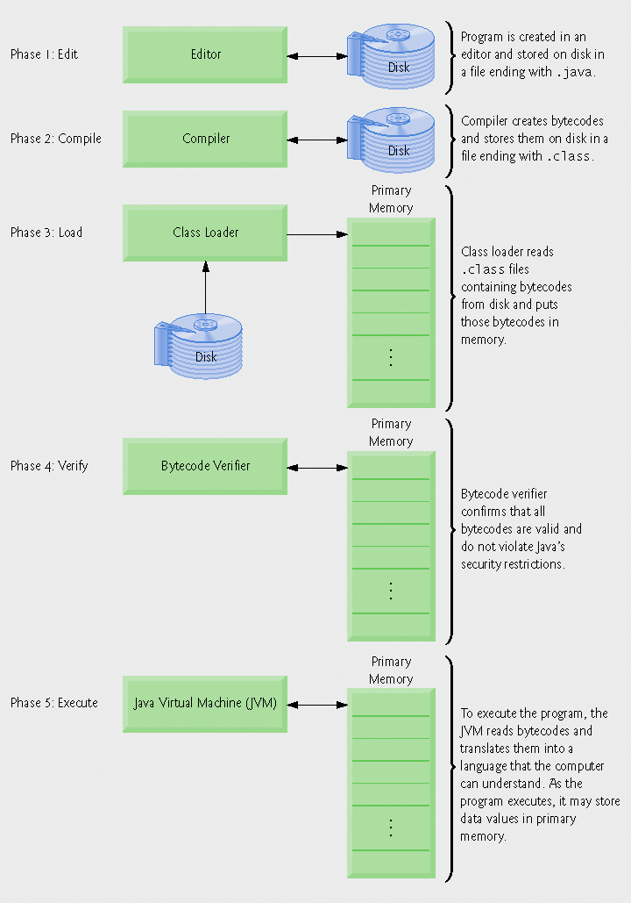
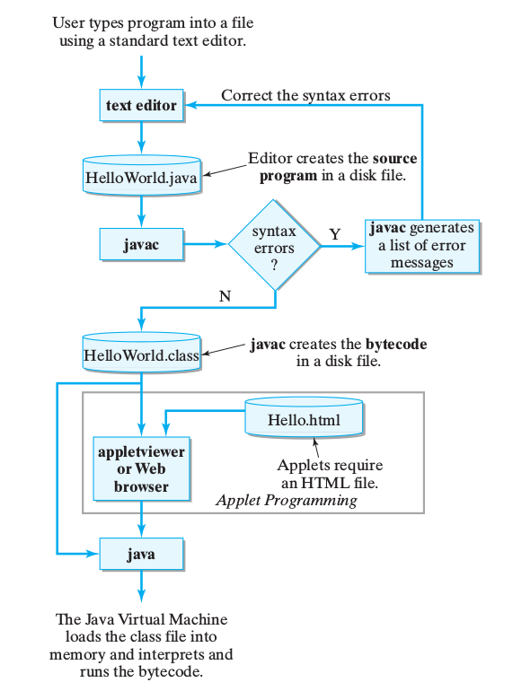
Typical Java Development Environment

Slide 7
First Program in Java
Key Components:
Comments
Line Numbers!
For reference only
Keywords
White Space
Readability
File Name
*.java
Same as public class name
main method
print statement

Slide 8
First Program in Java – Important Points
Every Java program has at least one user-defined class
Keyword: words reserved for use by Java
class keyword followed by class name
Naming classes: capitalize every word
SampleClassName
Java identifiers
Series of characters consisting of letters, digits, underscores ( _ ) and dollar signs ( $ )
Does not begin with a digit, has no spaces
Examples: Welcome1, $value, _value, button7
7button is invalid
Java is case sensitive (capitalization matters)
a1 and A1 are different

Slide 9
Good Programming Practice
By convention, always begin a class name’s identifier with a capital letter and start each subsequent word in the identifier with a capital letter. Java programmers know that such identifiers normally represent Java classes, so naming your classes in this manner makes your programs more readable.

Slide 10
Common Programming Errors
Java is case sensitive. Not using the proper uppercase and lowercase letters for an identifier normally causes a compilation error. Java is case sensitive. Not using the proper uppercase and lowercase letters for an identifier normally causes a compilation error.
It is an error for a public class to have a file name that is not identical to the class name (plus the .java extension) in terms of both spelling and capitalization.
It is a syntax error if braces do not occur in matching pairs.

Slide 11
Common Error Prevention Tips
When learning how to program, sometimes it is helpful to “break” a working program so you can familiarize yourself with the compiler's syntax-error messages. These messages do not always state the exact problem in the code. When you encounter such syntax-error messages in the future, you will have an idea of what caused the error.
When the compiler reports a syntax error, the error may not be on the line number indicated by the error message. First, check the line for which the error was reported. If that line does not contain syntax errors, check several preceding lines.

Slide 12
Compiling & Executing a Java Program
Open a command prompt window, go to directory where program is stored
Type javac Welcome1.java
If no syntax errors, Welcome1.class is created
Has bytecodes that represent application
Bytecodes passed to JVM
Type java Welcome1
Launches JVM
JVM loads .class file for class Welcome1
.class extension omitted from command
JVM calls method main

Slide 13
Modifying the Java Program
Welcome2.java 1. Comments 2. Blank line 3. Begin class Welcome2 3.1 Method main 4. Method System.out.print 4.1 Method System.out.println 5. end main, Welcome2 Program Output
System.out.print keeps the cursor on the same line, so System.out.println continues on the same line.

Slide 14
A Slightly Different Version
Welcome3.java
1. main 2. System.out.println (uses \n for new line)
Program Output
Notice how a new line is output for each \n escape sequence.

Slide 15
Some Common Escape Sequences

Slide 16
Displaying Text with printf
Welcome4.java
main
printf
Program output
System.out.printf displays formatted data.

Slide 17
Another Java Application: Adding Integers
Use Scanner to read two integers from user
Some other methods to get input from user are:
http://stackoverflow.com/questions/5287538/how-can-i-get-the-user-input-in-java
Use printf to display sum of the two values
Use packages
By default, package java.lang is imported in every Java program; thus, java.lang is the only package in the Java API that does not require an import declaration.

Slide 18
Another Java Application: Adding Integers
import declaration imports class Scanner from package java.util.
Declare and initialize variable input, which is a Scanner.
Declare variables number1, number2 and sum.
Read an integer from the user and assign it to number1.

Slide 19
Another Java Application: Adding Integers
Read an integer from the user and assign it to number2.
Calculate the sum of the variables number1 and number2, assign result to sum.
Display the sum using formatted output.
Two integers entered by the user.

Slide 20
Import Declarations
import declarations are used by compiler to identify and locate classes used in Java programs
All import declarations must appear before the first class declaration in the file. Placing an import declaration inside a class declaration’s body or after a class declaration is a syntax error.
Forgetting to include an import declaration for a class used in your program typically results in a compilation error containing a message such as “cannot resolve symbol.”
When this occurs, check that you provided the proper import declarations and that the names in the import declarations are spelled correctly, including proper use of uppercase and lowercase letters.

Slide 21
Good Programming Practice – Tips
Declare each variable on a separate line. This format allows a descriptive comment to be easily inserted next to each declaration.
Choosing meaningful variable names helps a program to be self-documenting (i.e., one can understand the program simply by reading it rather than by reading manuals or viewing an excessive number of comments).
By convention, variable-name identifiers begin with a lowercase letter, and every word in the name after the first word begins with a capital letter. This convention is usually referred as camel case.

Slide 22

Memory Concepts
Variables
Every variable has a name, a type, a size and a value
Name corresponds to location in memory
When new value is placed into a variable, replaces (and destroys) previous value
Reading variables from memory does not change them

Slide 23
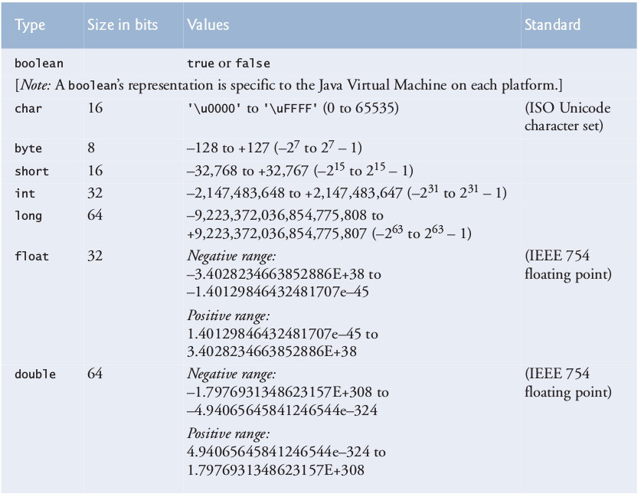
Primitive Data Types in Java

Slide 24
Arithmetic Operations
Arithmetic calculations used in most programs
Usage
* for multiplication
/ for division
% for remainder
+, -
Integer division truncates remainder (no rounding off)
7 / 5 evaluates to 1
Remainder operator % returns the remainder
7 % 5 evaluates to 2

Slide 25
Operator Precedence
Some arithmetic operators act before others (i.e., multiplication before addition)
Use parenthesis when needed
Example: Find the average of three variables a, b and c
Do not use: a + b + c / 3
Use: ( a + b + c ) / 3
Question: How the following expression will be evaluated?
Y = 2 * 5 * 5 + 3 * 5 + 7;

Slide 26
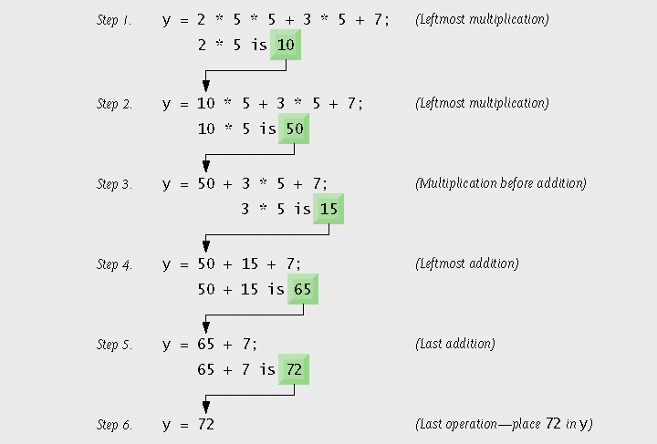
Operator Precedence

Slide 27
Operator Precedence
Tip: Using parentheses for complex arithmetic expressions, even when the parentheses are not necessary, can make the arithmetic expressions easier to read.

Slide 28
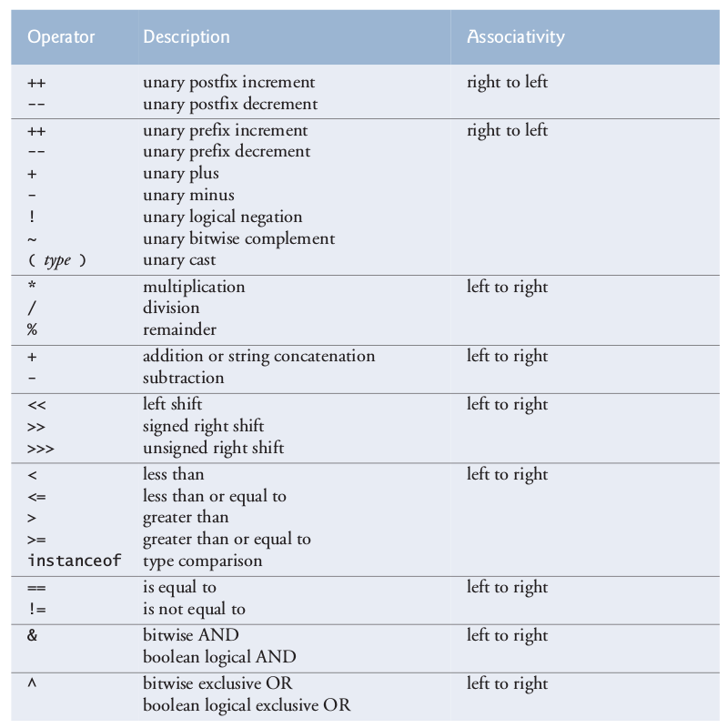
Operator Precedence

Slide 29
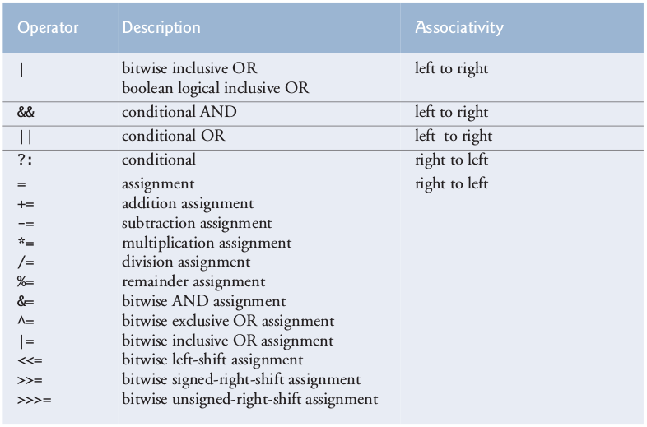
Operator Precedence

Slide 30
Questions/Answers &
Discussion

